Slide 1
Fundamentals of Computer Vision
Explaining theory through practice.
Doing practice in Python!

Slide 2
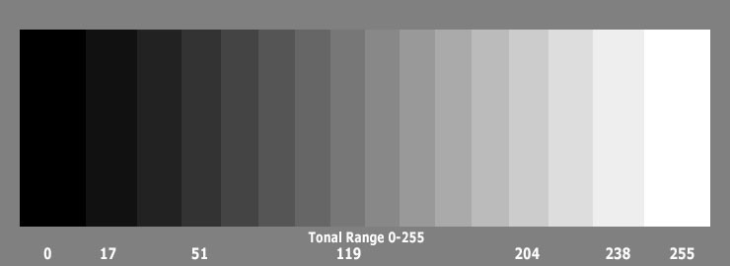
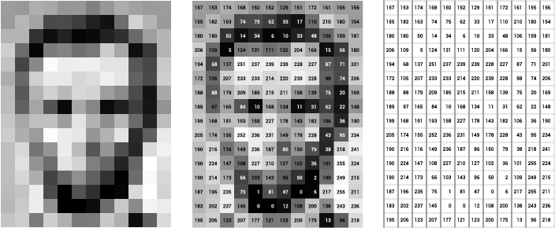
Digital Image Gray
Image Courtesy: ai.stanford.edu

Slide 3
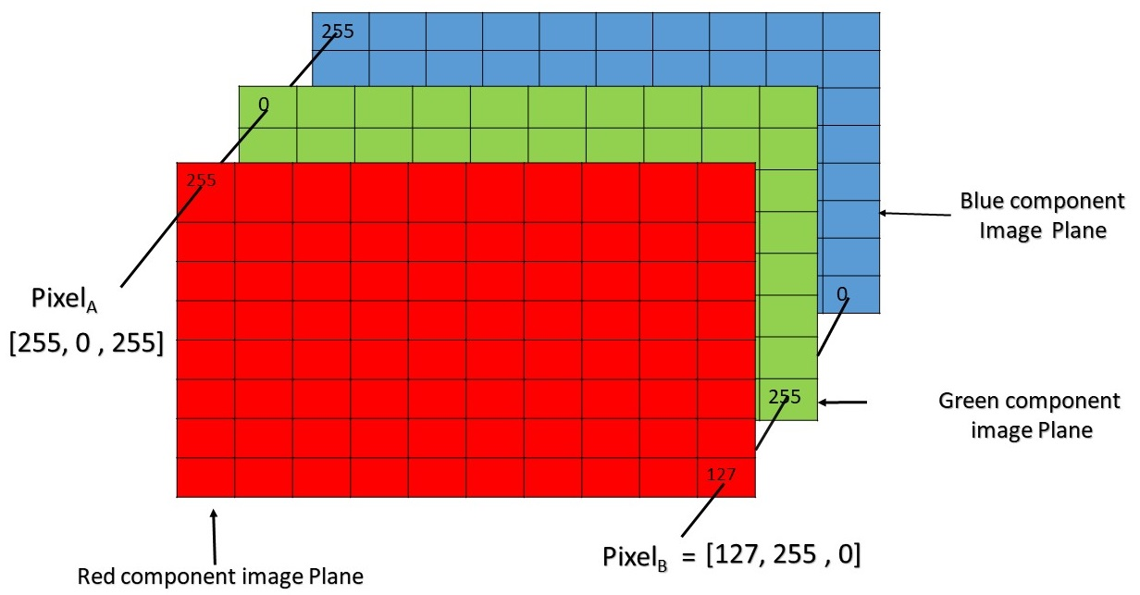
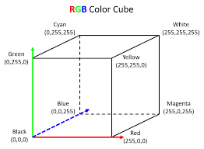
Digital Image RGB
Image Courtesy: GeeksforGeeks.org

Slide 4
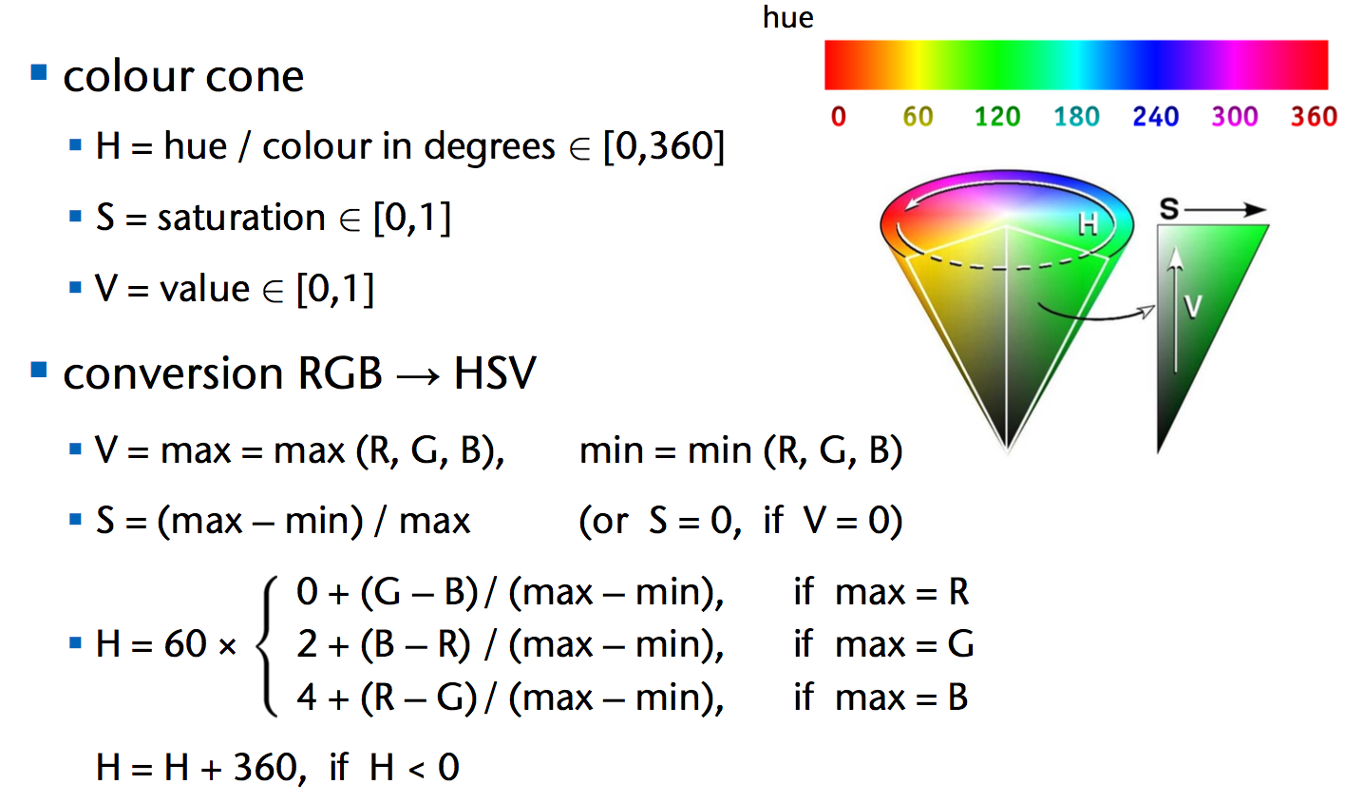
Colour Space HSV example

Slide 5
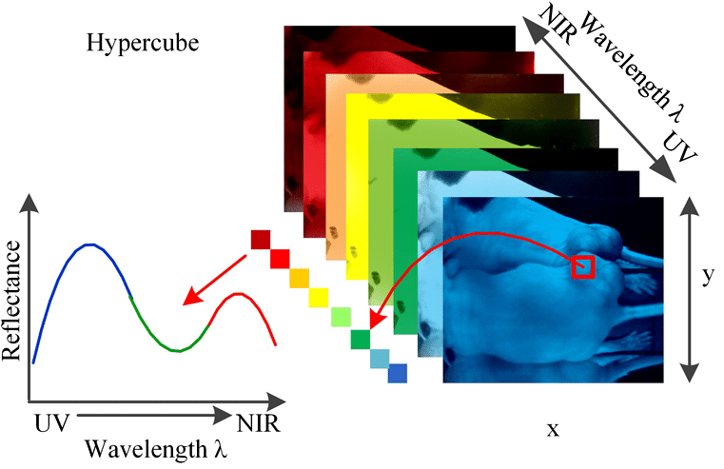
Hyperspectral Images

Slide 6
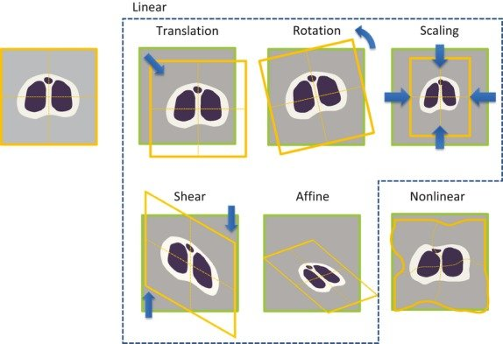
Geometric Transformations Spatial Transformations
Courtesy: researchgate.net

Slide 7
Geometric Transformations Spatial Transformations
Point correspondences
Courtesy: researchgate.net

Slide 8
Geometric Transformations Spatial Transformations
Point correspondences
Data augmentation
Courtesy: researchgate.net

Slide 9

Geometric Transformations Spatial Transformations
Point correspondences
Data augmentation
Building panoramas
Courtesy: researchgate.net

Slide 10
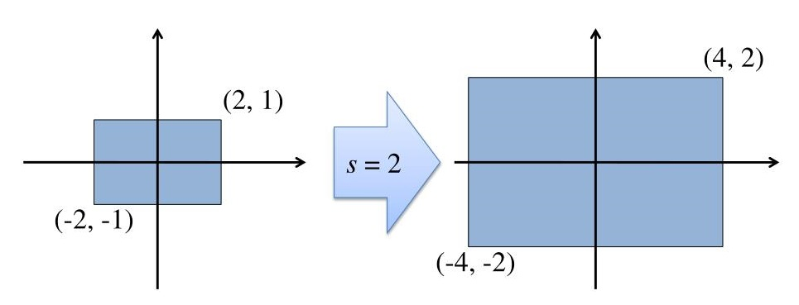
Geometric Transformations Scaling

Slide 11
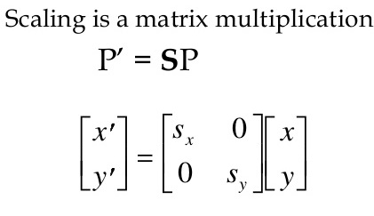
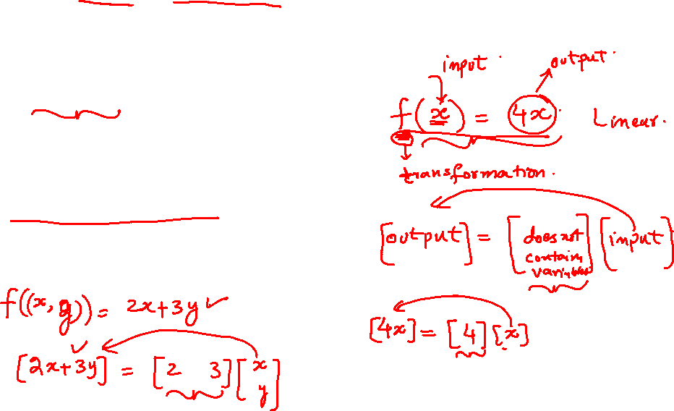
Geometric Transformations Scaling is a Linear Transformation

Slide 12
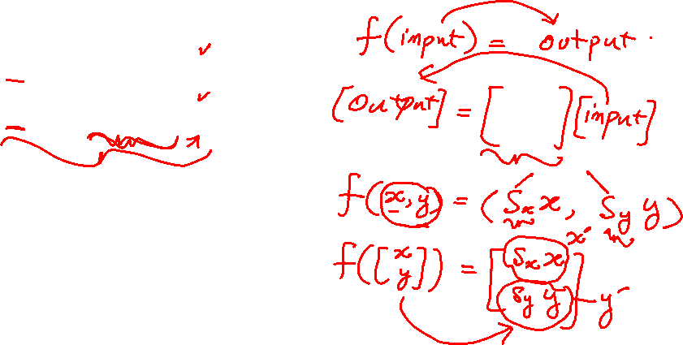
Geometric Transformations Scaling is a Linear Transformation

Slide 13
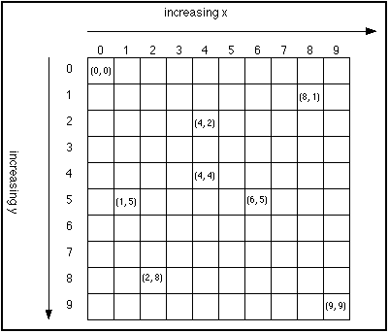
Geometric Transformations Scaling Images
Courtesy:cafeaulait.org

Slide 14
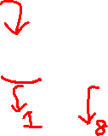
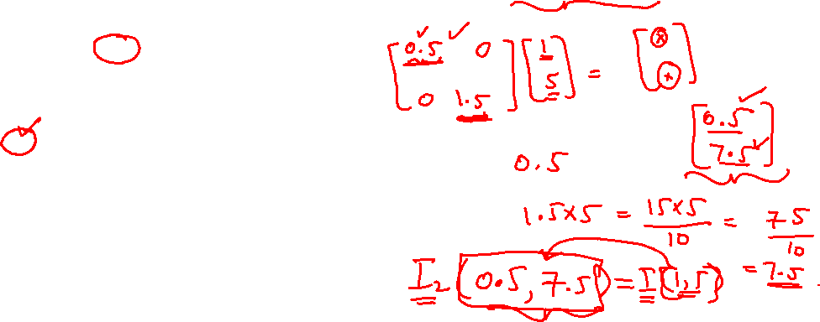
Geometric Transformations Scaling Images
The transformed coordinates may be continuous.
Courtesy:cafeaulait.org

Slide 15
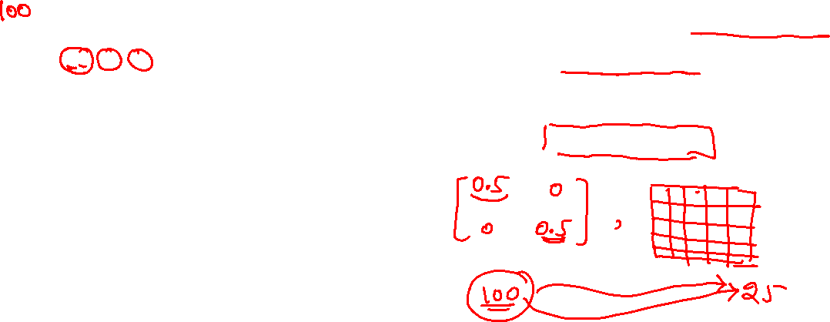
Geometric Transformations Scaling Images
The transformed coordinates may be continuous.
For small scaling factors, there may be saturations.
Courtesy:cafeaulait.org

Slide 16
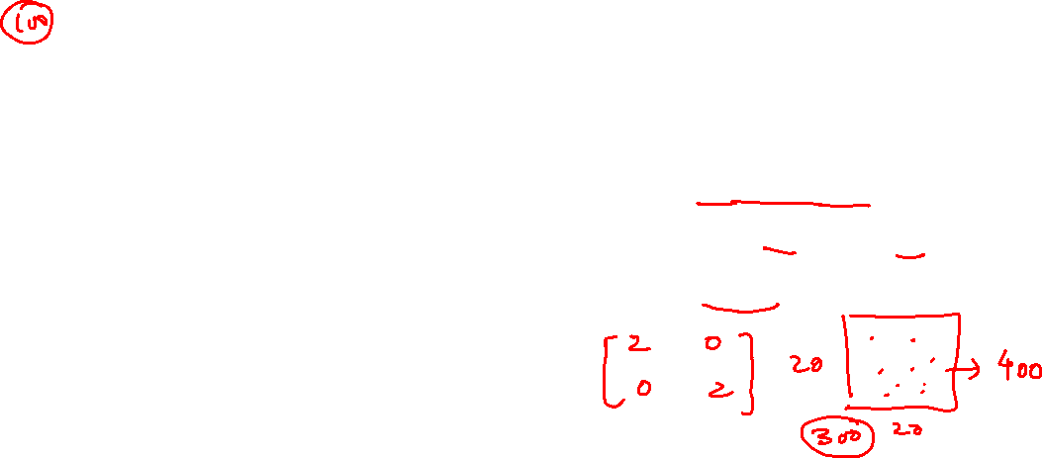
Geometric Transformations Scaling Images
The transformed coordinates may be continuous.
For small scaling factors, there may be saturations.
For large scaling factors, there may be holes.
Courtesy:cafeaulait.org

Slide 17

Geometric Transformations Scaling Images
The transformed coordinates may be continuous.
For small scaling factors, there may be saturations.
For large scaling factors, there may be holes.
…
Inverse Transformation
Courtesy:cafeaulait.org

Slide 18
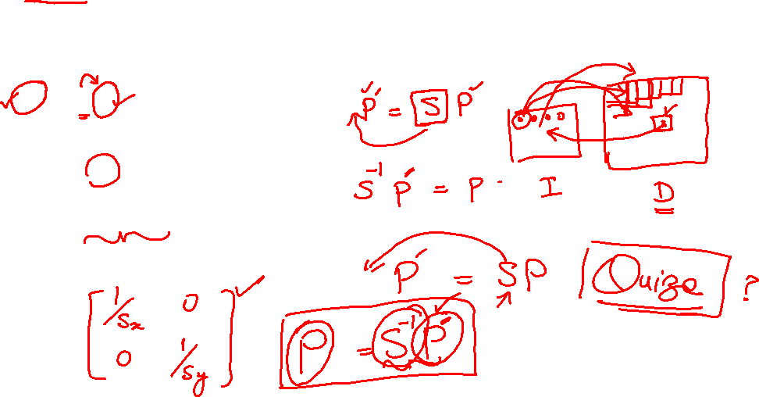
Geometric Transformations Inverse Scaling

Slide 19
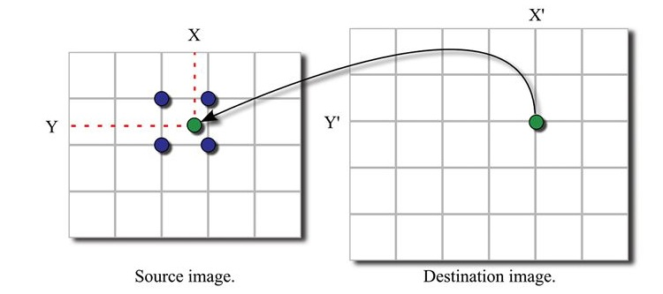
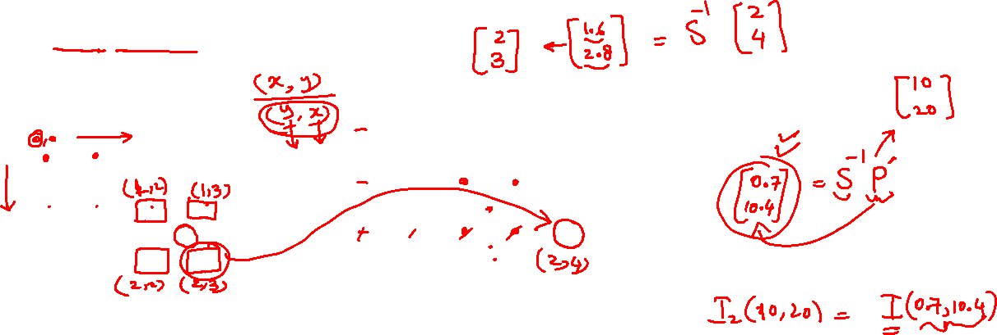
Geometric Transformations Interpolation

Slide 20
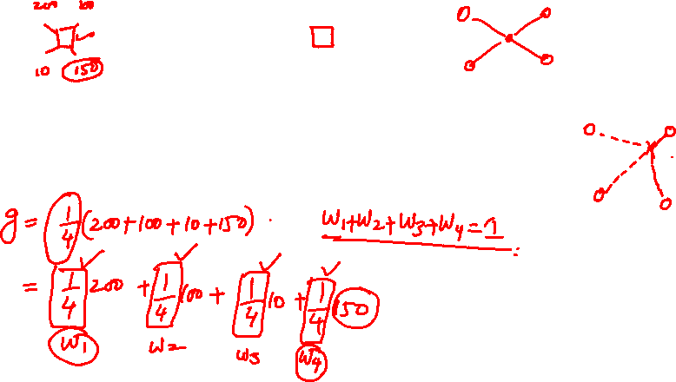
Geometric Transformations Interpolation

Slide 21
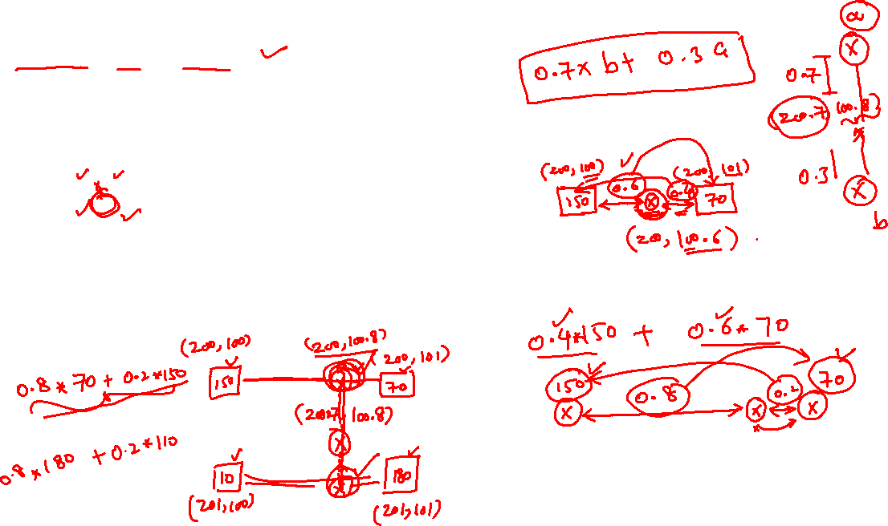
Geometric Transformations Bilinear Interpolation

Slide 22
Geometric Transformations Scaling Images: Algorithm
Image I, and scale factors Sx and Sy are given

Slide 23
Geometric Transformations Scaling Images: Algorithm
Image I, and scale factors Sx and Sy are given
Transform image extents to get the resultant image size

Slide 24
Geometric Transformations Scaling Images: Algorithm
Image I, and scale factors Sx and Sy are given
Transform image extents to get the resultant image size
Initialize the resultant image with all zeros

Slide 25
Geometric Transformations Scaling Images: Algorithm
Image I, and scale factors Sx and Sy are given
Transform image extents to get the resultant image size
Initialize the resultant image with all zeros
Compute the inverse transformation matrix :Tinv

Slide 26
Geometric Transformations Scaling Images: Algorithm
Image I, and scale factors Sx and Sy are given
Transform image extents to get the resultant image size
Initialize the resultant image with all zeros
Compute the inverse transformation matrix :Tinv
For each pixel location (a,b) in resultant image:

Slide 27
Geometric Transformations Scaling Images: Algorithm
Image I, and scale factors Sx and Sy are given
Transform image extents to get the resultant image size
Initialize the resultant image with all zeros
Compute the inverse transformation matrix :Tinv
For each pixel location (a,b) in resultant image:
Apply Tinv on (a,b) and get (c,d) in the source image

Slide 28
Geometric Transformations Scaling Images: Algorithm
Image I, and scale factors Sx and Sy are given
Transform image extents to get the resultant image size
Initialize the resultant image with all zeros
Compute the inverse transformation matrix :Tinv
For each pixel location (a,b) in resultant image:
Apply Tinv on (a,b) and get (c,d) in the source image
Apply interpolation on (c,d) and get intensity g

Slide 29
Geometric Transformations Scaling Images: Algorithm
Image I, and scale factors Sx and Sy are given
Transform image extents to get the resultant image size
Initialize the resultant image with all zeros
Compute the inverse transformation matrix :Tinv
For each pixel location (a,b) in resultant image:
Apply Tinv on (a,b) and get (c,d) in the source image
Apply interpolation on (c,d) and get intensity g
Copy intensity g on location (a,b) in the resultant image

Slide 30
Geometric Transformations Scaling Images: Quiz
Write the code in function form in Python, and compute the resultant image size with respect to the given transformation matrix.

Slide 31
Geometric Transformations Scaling Images: Quiz
Write the code in function form in Python, and compute the resultant image size with respect to the given transformation matrix.
Extend your code to handle colored images

Slide 32
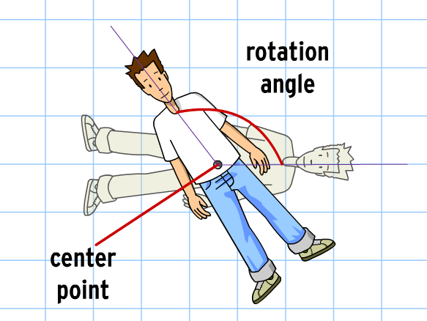
Geometric Transformations Rotation
Courtesy:brainpop.com

Slide 33
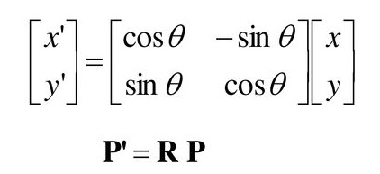
Geometric Transformations Rotation is a Linear Transformation
Courtesy:brainpop.com

Slide 34






Geometric Transformations Proof: Rotation is linear

Slide 35
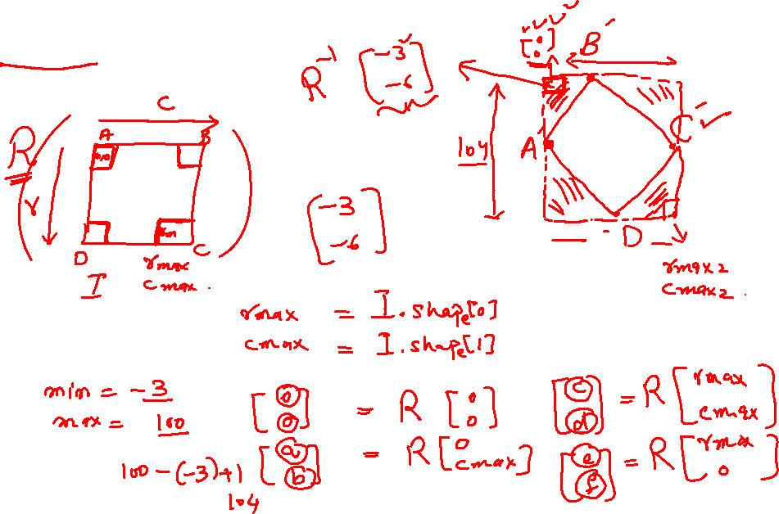
Geometric Transformations Rotation on Images

Slide 36
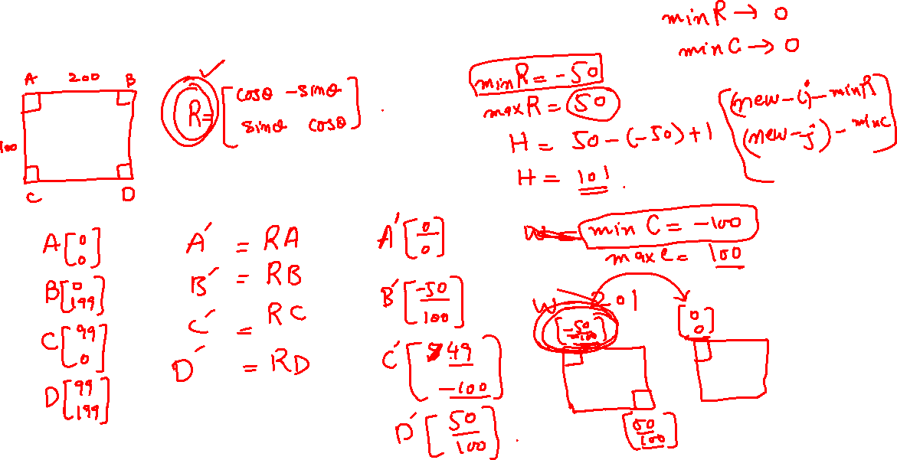
Geometric Transformations Rotation on Images

Slide 37
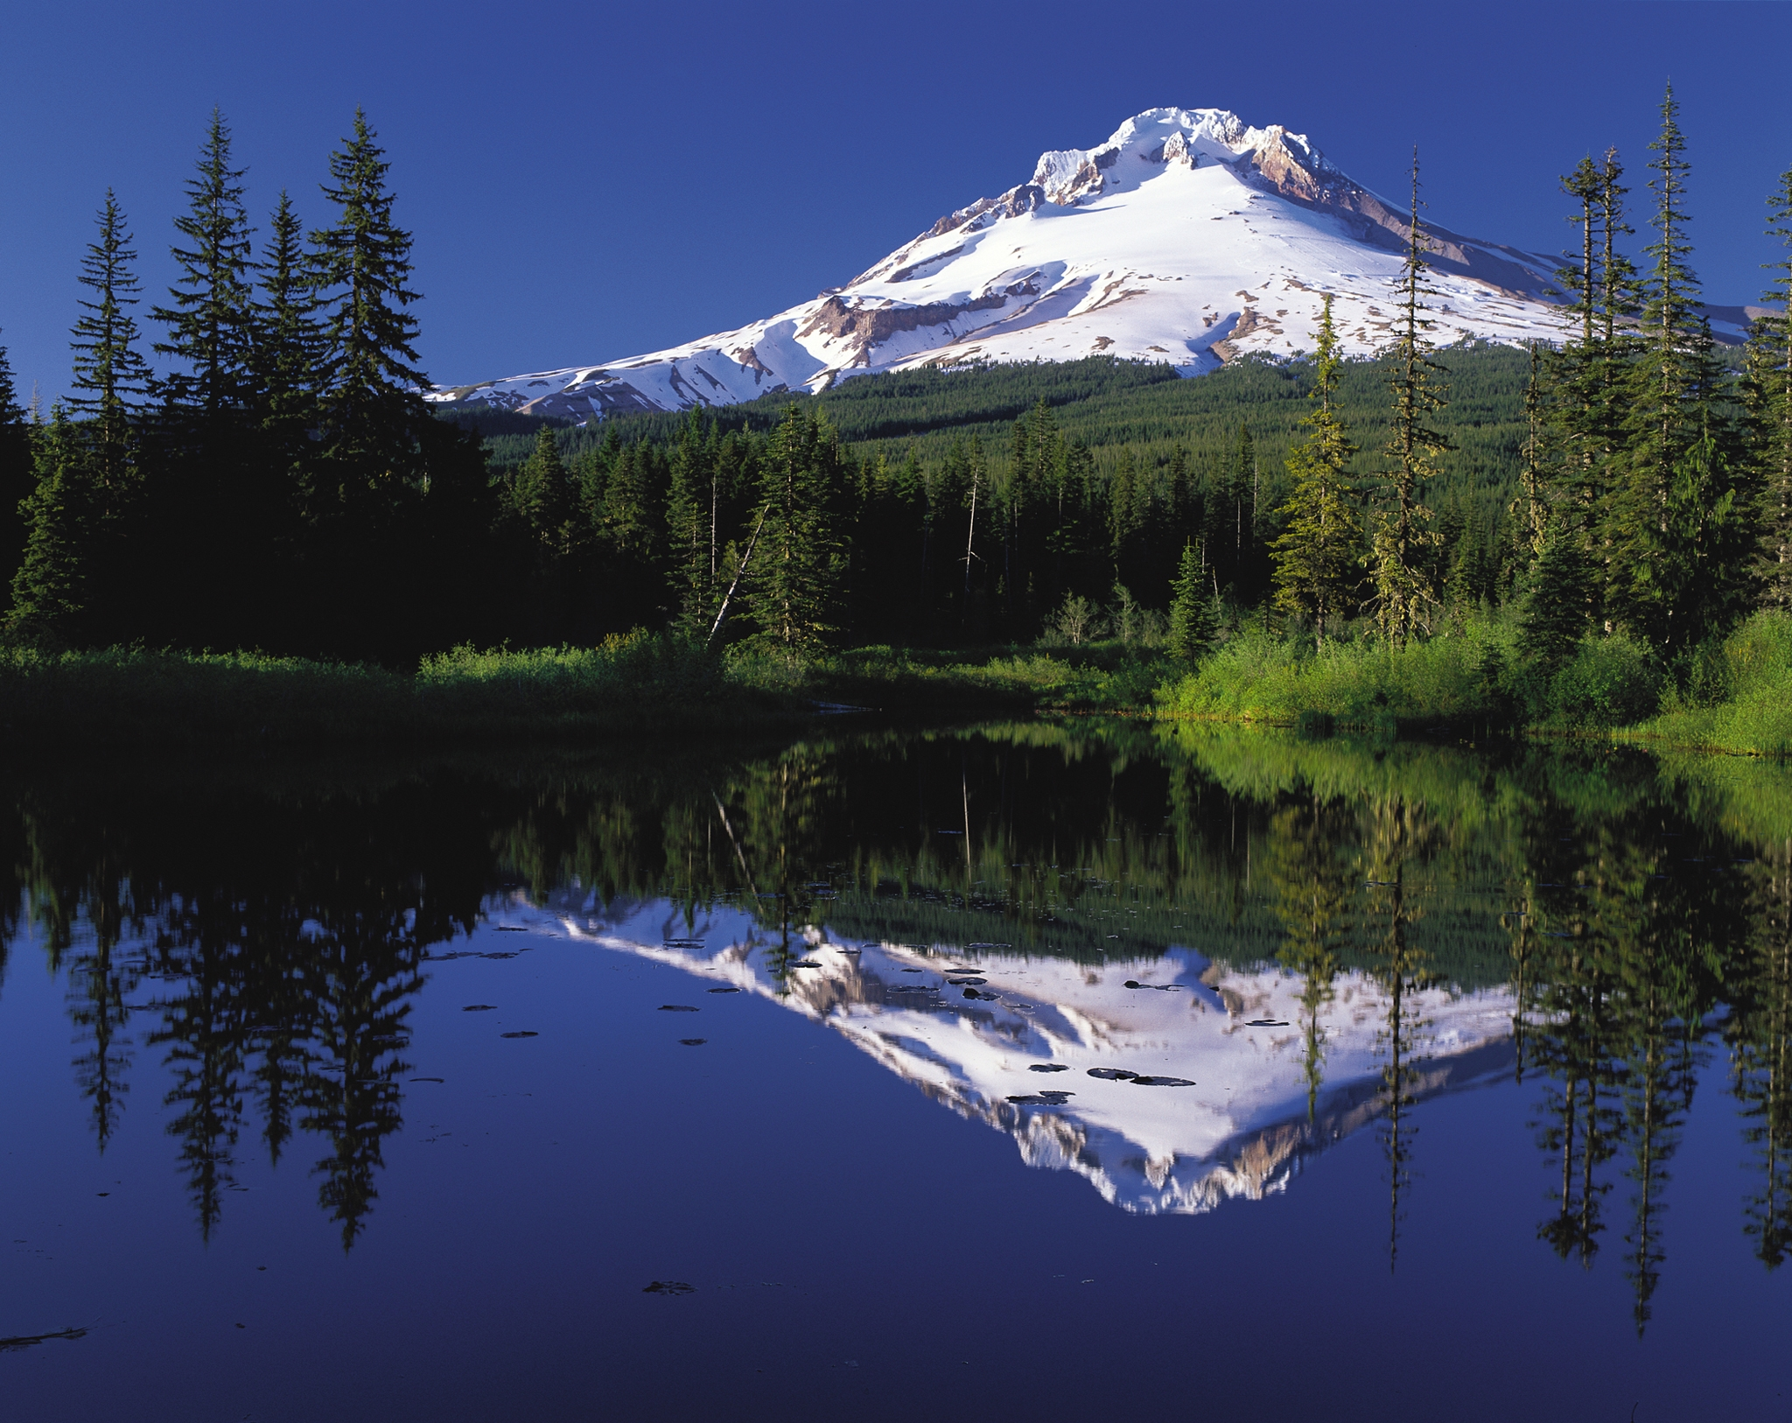
Geometric Transformations Reflection
Courtesy: wikipedia.org

Slide 38
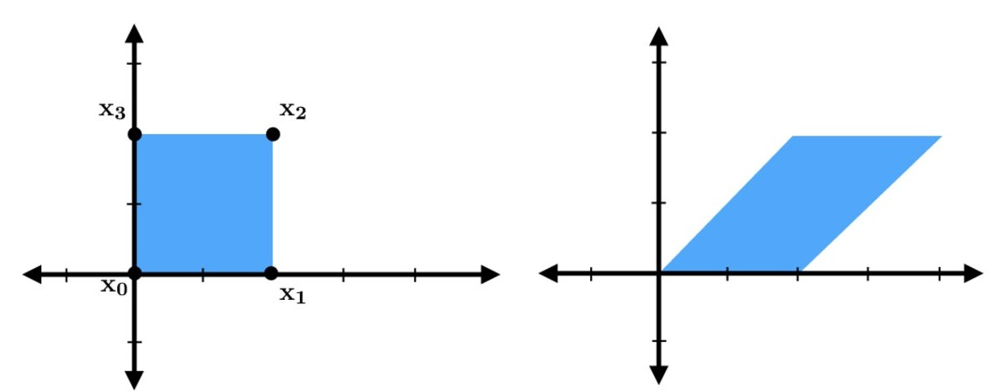
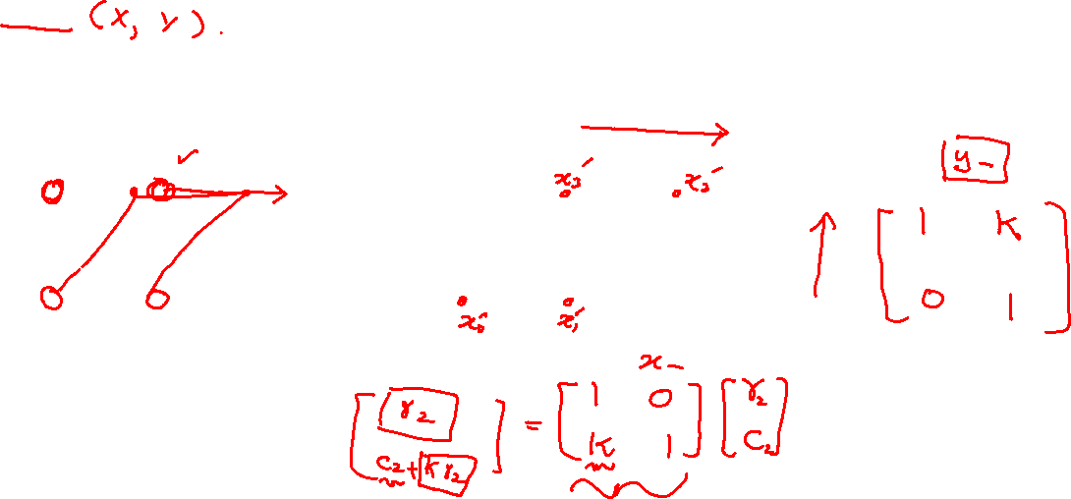
Geometric Transformations Shear

Slide 39
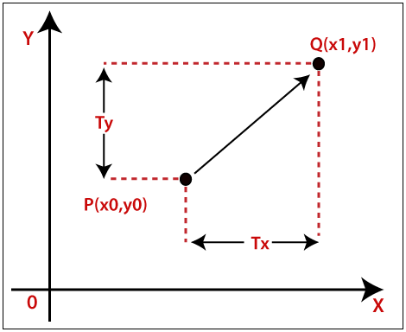
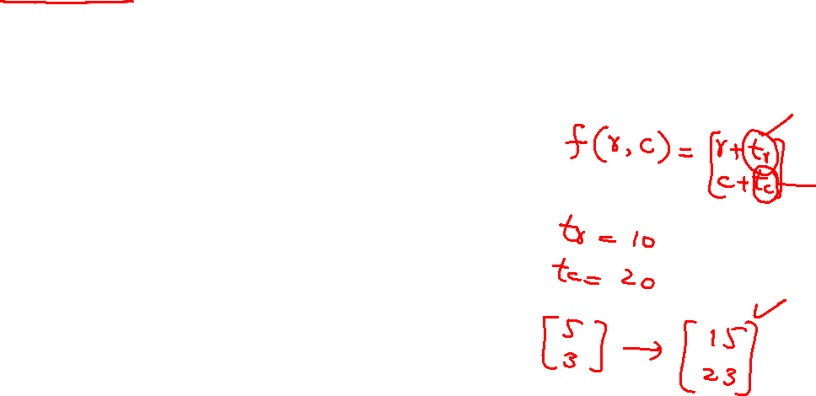
Geometric Transformations Translation
Courtesy: tutorialandexample.com

Slide 40
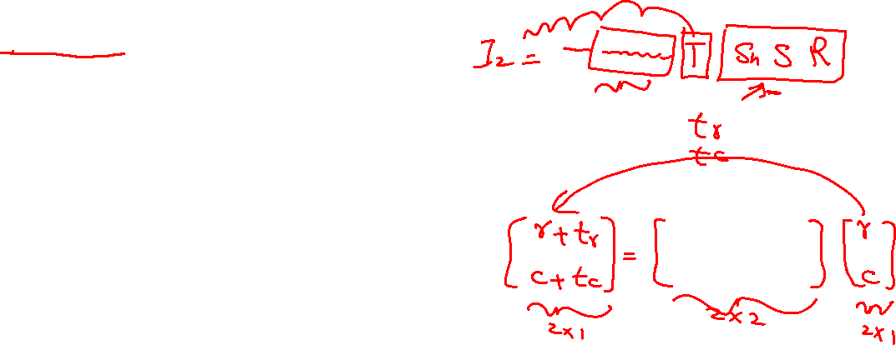
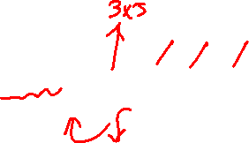
Geometric Transformations Translation is non linear
Courtesy: tutorialandexample.com

Slide 41
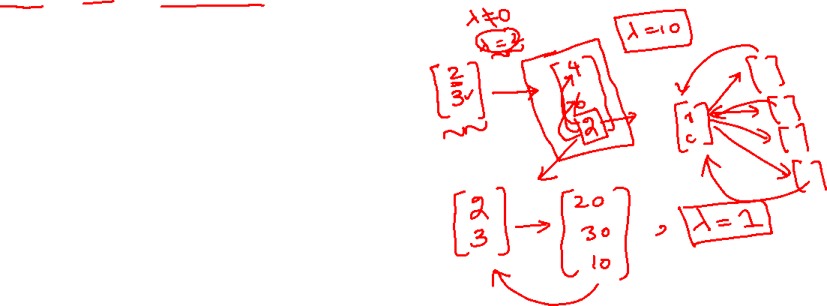
Geometric Transformations Homogeneous coordinates
Courtesy: tutorialandexample.com

Slide 42
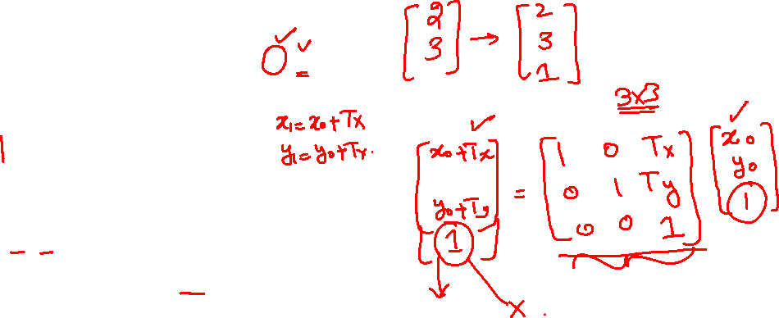
Geometric Transformations Homogeneous coordinates: Translation
Courtesy: tutorialandexample.com

Slide 43
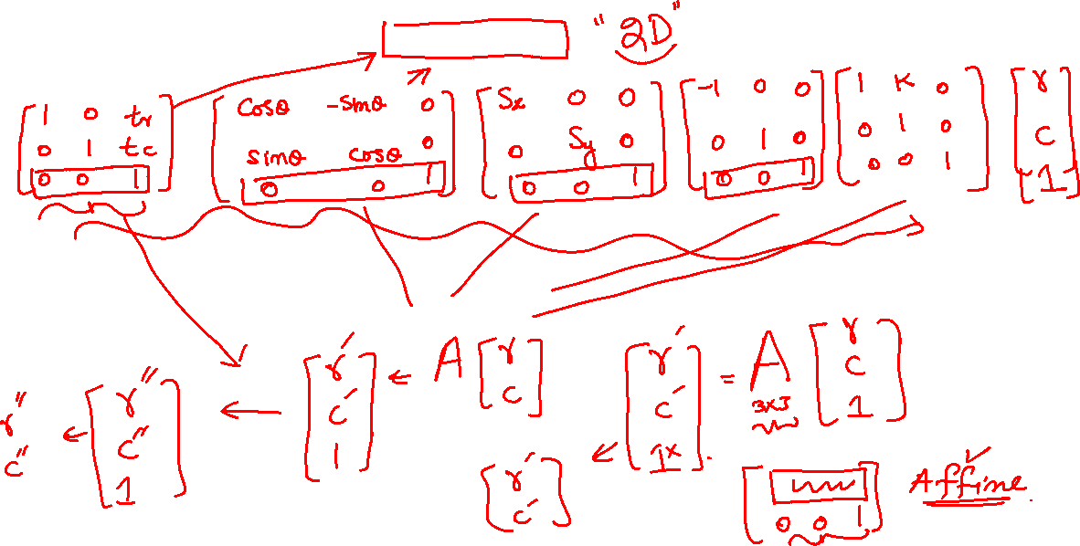
Geometric Transformations Homogeneous coordinates: 3x3 matrices

Slide 44
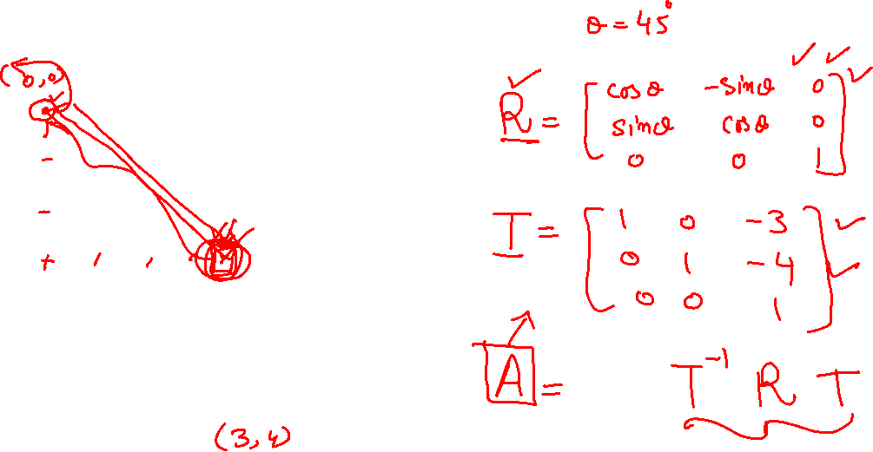
Geometric Transformations Rotation about any point

Slide 45
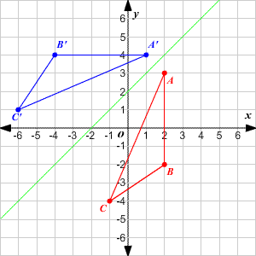
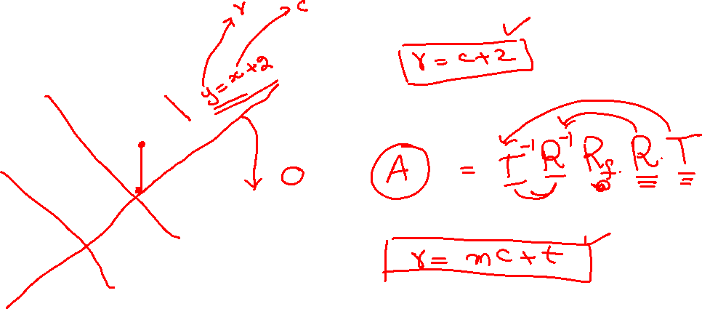
Geometric Transformations Reflection about a line
Courtesy: thinglink.com

Slide 46
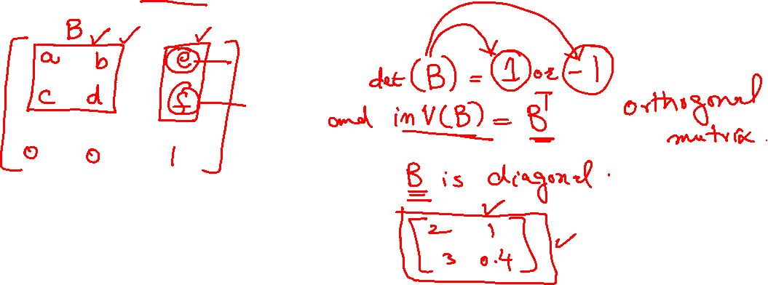
Geometric Transformations Transformation matrix properties

Slide 47
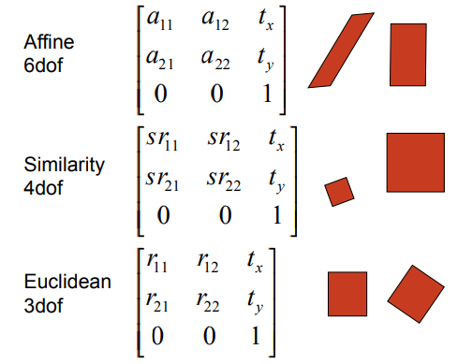
Geometric Transformations Affine Transformation

Slide 48
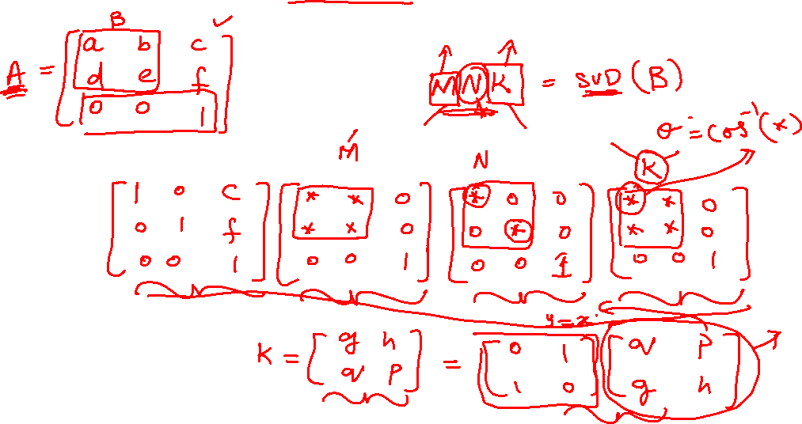
Geometric Transformations Affine Transformation factorization

Slide 49
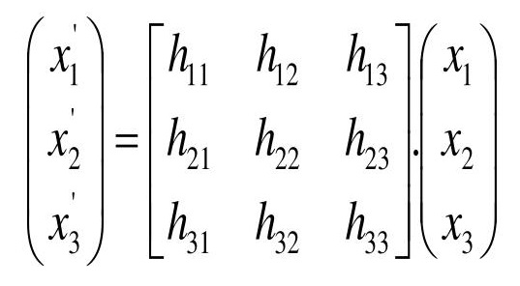
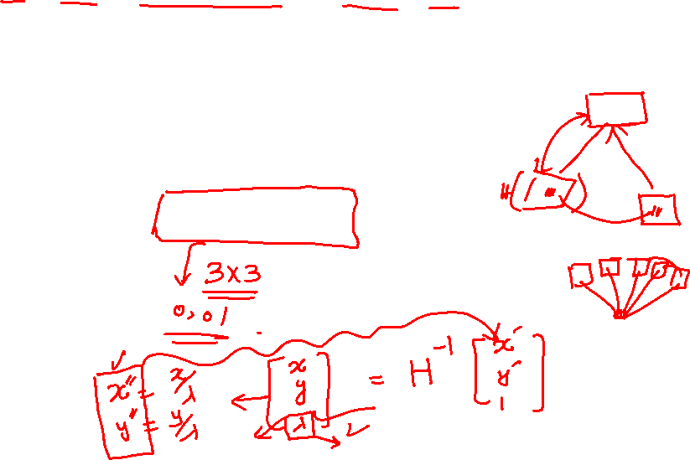
Geometric Transformations Projective Transformation (Homography)

Slide 50
Geometric Transformations Projective Warping
Image I, and Projective matrix H
Transform image extents to get the resultant image size
Initialize the resultant image with all zeros
Compute the inverse transformation matrix :Tinv
For each pixel location (a,b,1) in resultant image:
Apply Tinv on (a,b,1) and get (c,d) in the source image
Apply interpolation on (c,d) and get intensity g
Copy intensity g on location (a,b) in the resultant image

Slide 51
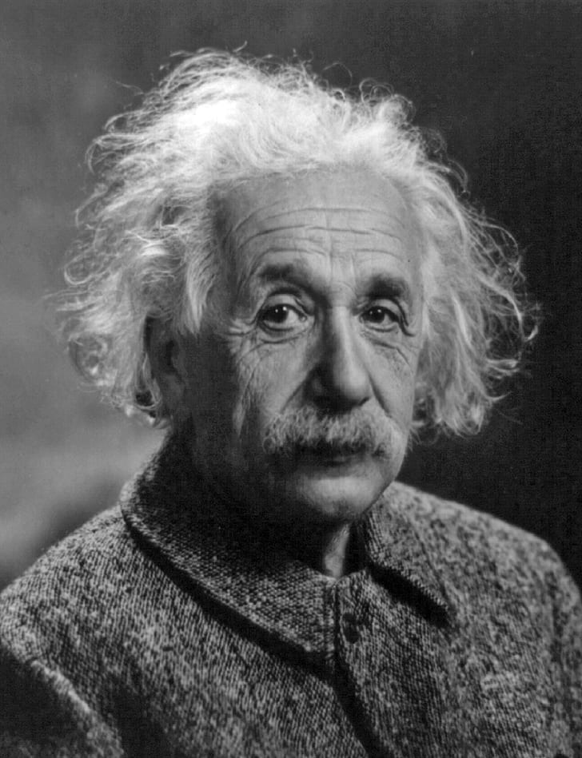
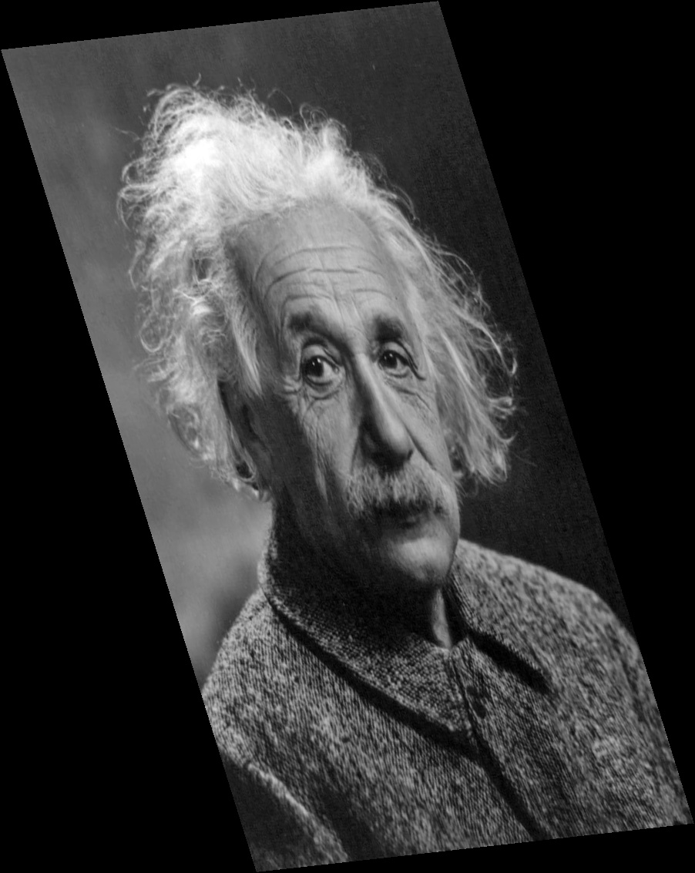
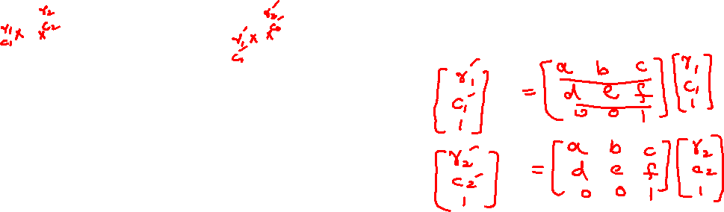
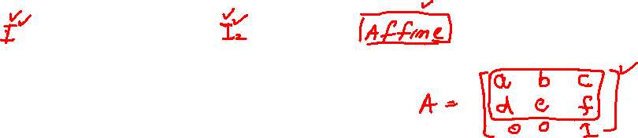
Geometric Transformations Estimating Affine Transformation

Slide 52
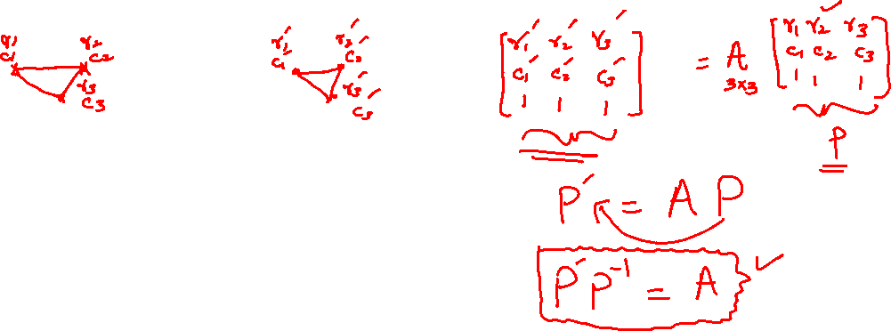
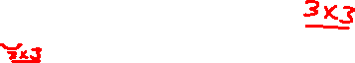
Geometric Transformations Estimating Affine Transformation

Slide 53
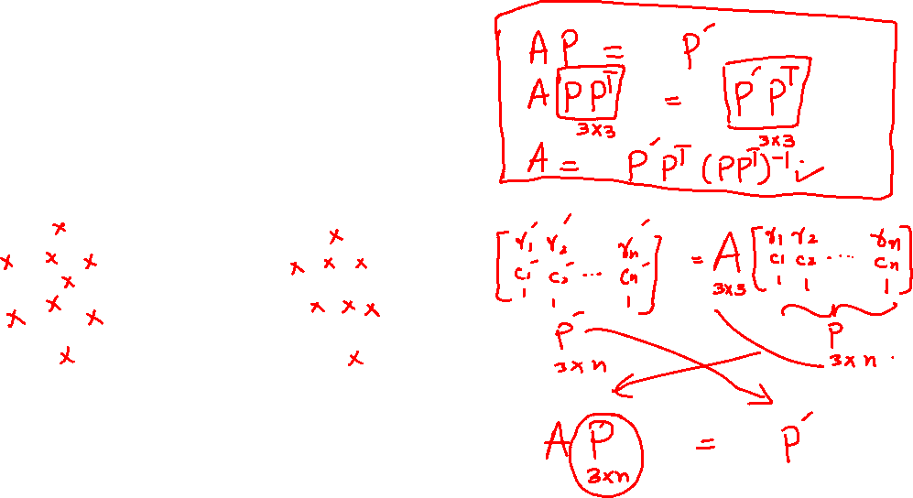
Geometric Transformations Estimating Affine Transformation

Slide 54

Geometric Transformations Estimating Affine Transformation: Least Squared

Slide 55



Geometric Transformations Estimating Projective Transformation

Slide 56


Geometric Transformations Estimating Projective Transformation: DLT
Courtesy: Kris Kitani (CMU)

Slide 57


Geometric Transformations Estimating Projective Transformation: DLT
Courtesy: Kris Kitani (CMU)

Slide 58


Geometric Transformations Estimating Projective Transformation: DLT
Courtesy: Kris Kitani (CMU)

Slide 59


Geometric Transformations Estimating Projective Transformation: DLT
Courtesy: Kris Kitani (CMU)

Slide 60


Geometric Transformations Estimating Projective Transformation: DLT
Courtesy: Kris Kitani (CMU)

Slide 61


Geometric Transformations Estimating Projective Transformation: DLT
Courtesy: Kris Kitani (CMU)

Slide 62

Geometric Transformations Estimating Projective Transformation: DLT
Courtesy: Kris Kitani (CMU)

Slide 63

Geometric Transformations Estimating Projective Transformation: DLT
Courtesy: Kris Kitani (CMU)

Slide 64




Geometric Transformations Panorama

Slide 65

Binary Morphology Binary Images

Slide 66

Binary Morphology Structuring Element
kernel = np.ones((2,2),np.uint8)
Courtesy: www.cs.auckland.ac.nz
cv2.getStructuringElement(cv2.MORPH_RECT,(5,5))
cv2.getStructuringElement(cv2.MORPH_ELLIPSE,(5,5))
cv2.getStructuringElement(cv2.MORPH_CROSS,(5,5))

Slide 67
Binary Morphology Erosion
erosion = cv2.erode(img,kernel)
Courtesy: www.cs.auckland.ac.nz

Slide 68
Binary Morphology Dilation
erosion = cv2.dilate(img,kernel)
Courtesy: www.cs.auckland.ac.nz

Slide 69

Binary Morphology Opening
Erosion followed by dilation
R = cv2.morphologyEx(img, cv2.MORPH_OPEN, kernel)

Slide 70

Binary Morphology Closing
Dilation followed by Erosion
R = cv2.morphologyEx(img, cv2.MORPH_CLOSE, kernel)

Slide 71

Binary Morphology Gradient
Dilation - Erosion
R = cv2.morphologyEx(img, cv2.MORPH_GRADIENT, kernel)

Slide 72

Binary Morphology Top Hat
Input - Opening
R = cv2.morphologyEx(img, cv2.MORPH_TOPHAT, kernel)

Slide 73

Binary Morphology Black Hat
Closing - Input
R = cv2.morphologyEx(img, cv2.MORPH_BLACKHAT, kernel)

Slide 74


Image Blurring
Image Courtesy: Teckmixer.com

Slide 75


Image Blurring

Slide 76

General Image Filtering
Image Courtesy: slideshare.net

Slide 77

Convolution
Image Courtesy: slideshare.net

Slide 78

Edge Detection
Image Courtesy: pyimagesearch.com

Slide 79

Image Sharpening
Image Courtesy: enviragallery.com

Slide 80
Image Filtering Low-pass and High-pass

Slide 81


Canny Edge Detection Algorithm

Slide 82



Canny Edge Detection Gaussian filter
Courtesy:librow.com

Slide 83
Canny Edge Detection Gaussian filter

Slide 84

Canny Edge Detection Gaussian filter: choice of sigma

Slide 85
Canny Edge Detection Gradients

Slide 86
Canny Edge Detection Gradients

Slide 87

Canny Edge Detection Gaussian filter: Derivative of Gaussian

Slide 88

Canny Edge Detection Non-maxima suppression

Slide 89
Canny Edge Detection Non-maxima suppression

Slide 90

Canny Edge Detection hysteresis thresholding

Slide 91


Shape Detection Line detection

Slide 92

Shape Detection Line detection: Edge detection is not sufficient

Slide 93


Shape Detection RANSAC

Slide 94
Shape Detection RANSAC: Lines

Slide 95
Shape Detection RANSAC: Lines

Slide 96
Shape Detection RANSAC: Circles

Slide 97
Shape Detection RANSAC: General

Slide 98

Shape Detection RANSAC: Affine Transformation

Slide 99
Shape Detection RANSAC: Affine Transformation

Slide 100
Shape Detection Hough Transform

Slide 101
Shape Detection Hough Transform: Line

Slide 102
Shape Detection Hough: Lines

Slide 103

Shape Detection Hough: Lines

Slide 104
Shape Detection Hough: Lines

Slide 105
Shape Detection Hough: Lines

Slide 106
Shape Detection Hough: Fast: Lines using Gradient Direction

Slide 107
Shape Detection Hough: Circles

Slide 108

Corner Detection What is a corner?

Slide 109
Corner Detection Why corner?

Slide 110

Corner Detection How to detect a corner?

Slide 111

Corner Detection How to detect a corner?

Slide 112
Corner Detection Algorithm: Moravec
For each pixel, build a patch around it
Compare this patch with the neighboring patches
If it is dissimilar from all the patches, then the pixel is a corner

Slide 113

Corner Detection Scale issue

Slide 114

Corner Detection How to find the neighbours?

Slide 115
Corner Detection Harris corner detection

Slide 116
Corner Detection Harris corner detection

Slide 117
Corner Detection Harris corner detection

Slide 118
Corner Detection Harris corner detection

Slide 119
Corner Detection Harris corner detection

Slide 120
Corner Detection Harris corner detection

Slide 121
Corner Detection Harris corner detection: Structure Tensor

Slide 122
Point Correspondences Scale Invariant Feature Transform (SIFT)

Slide 123
Point Correspondences Scale Invariant Feature Transform (SIFT)

Slide 124
Point Correspondences Scale Invariant Feature Transform (SIFT)

Slide 125
Object Detection Convolutional Neural Networks

Slide 126

Motion Optical Flow

Slide 127
Motion Constant Brightness over time: Assumption

Slide 128
Motion Derivation (LK)

Slide 129

Object Tracking Tracking by detection

Slide 130
Object Tracking Motion Model Assumption

Slide 131
Object Tracking KLT

Slide 132

3D Reconstruction Camera

Slide 133

3D Reconstruction Camera

Slide 134



3D Reconstruction Camera
Assumptions
Camera Matrices are known
Image correspondences are known
The intersection of both the 3-D lines is the 3-D point X
What if camera matrix is not known?

Slide 135

3D Reconstruction Camera
DLT

Slide 136
3D Reconstruction Correspondences?

Slide 137

3D Reconstruction Mocap

Slide 138

3D Reconstruction Realistic modelling

Slide 139

Project Smart CCTV

Slide 140
Project Smart CCTV: Change Detection

Slide 141
Project Smart CCTV: Background Subtraction

Slide 142

Project Smart CCTV: Connected Components

Slide 143
Project Smart CCTV: Applications

